Slide 1
Employee Data Analysis using Excel
STUDENT NAME: A. Nagoormeera
REGISTER NO: 122200087
DEPARTMENT: B. Com(cs)
COLLEGE : Pachaiyappas college for women.

Slide 2
PROJECT TITLE
Using Pivot Tables for Employees Turnover Analysis

Slide 3


AGENDA
Problem Statement
Project Overview
End Users
Our Solution and Proposition
Dataset Description
Modelling Approach
Results and Discussion
Conclusion
3/21/2024 Annual Review

Slide 4

PROBLEM STATEMENT
The core or challenge the project aims to address.
As an HR Analyst, I need to analyze employee turnover data to identify trends, patterns, and insights that can inform strategies to reduce turnover.

Slide 5

PROJECT OVERVIEW
A high-level summary of the project's scope and goals.
.
Analyze employee turnover data to identify trends, patterns, and insights that can inform strategies to reduce turnover and improve retention.

Slide 6

WHO ARE THE END USERS?
The intended beneficiaries of the project's outcomes.
1. HR Business Partners: HR professionals who work closely with business leaders to develop and implement HR initiatives. 2. Talent Management Teams: Teams responsible for recruiting, developing, and retaining top talent within the organization.

Slide 7

OUR SOLUTION AND ITS VALUE PROPOSITION
The proposed approach or solution to the problem.
Data-Driven Insights: Unlock hidden trends and patterns in employee turnover data to inform strategic decisions. 2. Improved Retention: Identify key drivers of turnover and develop targeted retention strategies to reduce turnover and improve employee satisfaction.

Slide 8
Dataset Description
The proposed approach or solution to the problem.
1. Employee ID: Unique identifier for each employee 2. Department: Department or team the employee belongs to 3. Job Title: Employee's job title 4. Hire Date: Date the employee was hired

Slide 9

THE "WOW" IN OUR SOLUTION
There are multiple matches for "WoW" in relation to a solution, including a Way of Working, a WOW experience, and a WOW factor:
Way of Working (WoW)
A well-defined WoW can help organizations improve performance, collaboration, and productivity. It can also help create a culture of continuous improvement by providing a framework for identifying and solving problems.
3/21/2024 Annual Review
9

Slide 10
MODELLING
The techniques or algorithms employed for analysis.
1. Descriptive Analytics: Summarize and describe turnover data to understand trends and patterns. 2. Diagnostic Analytics: Identify key drivers of turnover and correlations with other HR metrics. 3. Predictive Analytics: Forecast future turnover rates and identify high-risk employees.
10

Slide 11
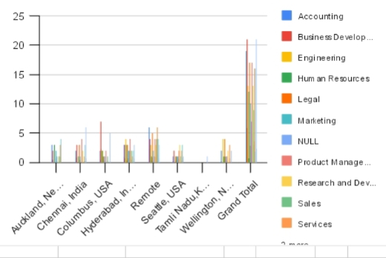
RESULTS
11

Slide 12
conclusion
Pivot tables can be valuable tool for analyzing and presenting data in the context of this agenda. By effectively using pivot tables, you can gain deeper insights into your data, identify patterns and trends, and communicate your findings more effectively. Would you like to explore a specific use case or discuss how to create a pivot table in your preferred software?

